Slide 1
CO2 Footprint Prediction
AI 4 CLIMATE

Slide 2


MEET THE TEAM
Full Name
Description (Blue is the colour of the clear sky and the deep sea)
Full Name
Description (Blue is the colour of the clear sky and the deep sea)
Full Name
Description (Blue is the colour of the clear sky and the deep sea)
Full Name
Description (Blue is the colour of the clear sky and the deep sea)
Full Name
Description (Blue is the colour of the clear sky and the deep sea)

Slide 3
MACHINE LEARNING MODEL
CHALLENGE:
A prediction model where we need to predicts which parameter from the 10 parameters highly contributes to CO2 emissions.
SOLUTION:
So, we used Linear Regressor.
The parameters that we tuned are:
Parameter 1
Parameter 2
Parameter 3
Parameter 4

Slide 4
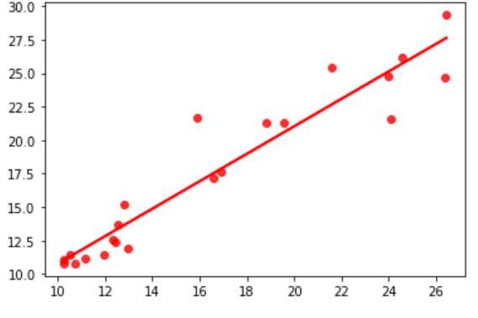
ACCURACIES
Training set accuracy: 94%
Testing set accuracy: 63%

Slide 5
AI IMPROVEMENTS
Improvements on the build AI Model:
Parameters
Data Sets
Algorithms

Slide 6
AI MODEL RESULTS
Highest Parameter
Lowest Parameter
Average Carbon Footprint (Individual)
Notes:
Highest and lowest parameter that contribute in CO2 emission

Slide 7
RECOMMENDATIONS – INDIVIDUAL LEVEL
Incorporate walking or biking to some of your regular short-trip destinations
Turn off lights and unplug devices when you’re not using them
1
2
3
4
Eat more food that is grown or made locally and less red meat.
Use alternative transportation (bus or train) to get to work one day per week

Slide 8
RECOMMENDATIONS – INDUSTRY LEVEL
Leverage electricity and heat from nearby zero carbon sources (wind, solar, nuclear, biomass)
Use produced hydrogen as an alternative fuel for hard-to-electrify industrial processes, building heating and transport.
1
2
3
4
Follow the principle of eco-design by considering factors such as the amount of energy and materials consumed in production.
Reclaim used durable materials, such as steels, and products that can be reused in future manufacturing processes.

Slide 9
DEPLOYMENT OF MODEL

